Slide 1
L5_Algorithm Design Techniques
Dr. Jay Dave
CSIS Dept, Hyderabad Campus

Slide 2
Data Structures and Algorithms Design (Merged-SEZG519/SSZG519)
L5_Algorithm Design Techniques

Slide 3
Content of L-5
5.1. Greedy Method
5.1.1. Design Principles and Strategy
5.1.2. Fractional Knapsack Problem
5.1.3. Task Scheduling Problem
5.2. Divide and Conquer
5.2.1. Design Principles and Strategy
5.2.2. Analyzing Divide and Conquer Algorithms
5.2.3. Integer Multiplication Problem
5.2.4. Sorting Problem
5.2.4.1. Merge Sort Algorithm
5.2.4.2. Quick Sort Algorithm
5.2.5. Searching Problem and Binary Search Algorithm [Ref to 4.4.1]
5.3. Dynamic Programming
5.3.1. Design Principles and Strategy
5.3.2. Matrix Chain Product Problem
5.3.3. 0/1 Knapsack Problem

Slide 4
Content of L-5
5.4. Graph Algorithms
5.4.1. Introduction to Graphs
5.4.2. Prim's and Kruskal's Algorithms [Greedy]
5.4.3. Dijkstra’s Algorithm [Greedy]
5.4.4. Bellman-ford Shortest Path Algorithm [Dynamic Programming]
5.4.5. All Pair Shortest Path Algorithm [Dynamic Programming]

Slide 5
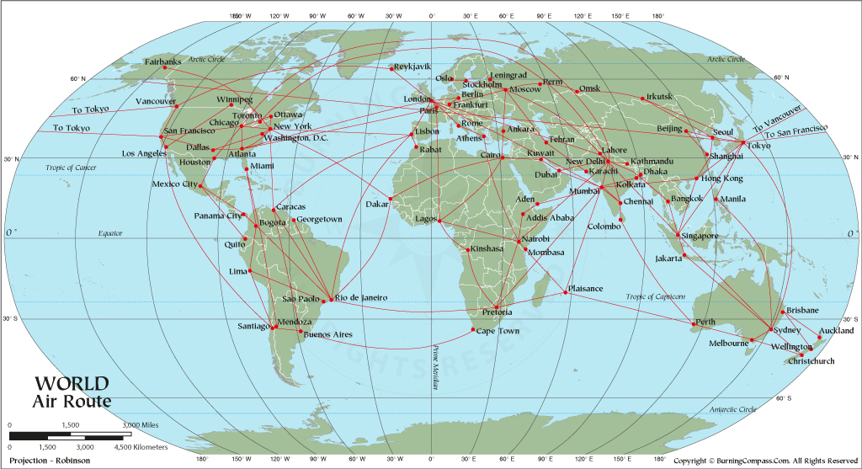
Graph

Slide 6
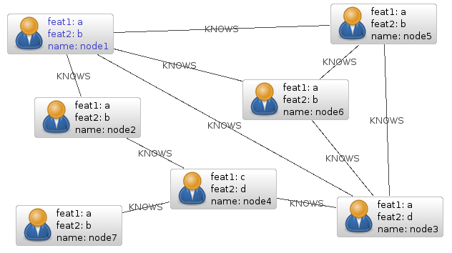
Graph

Slide 7
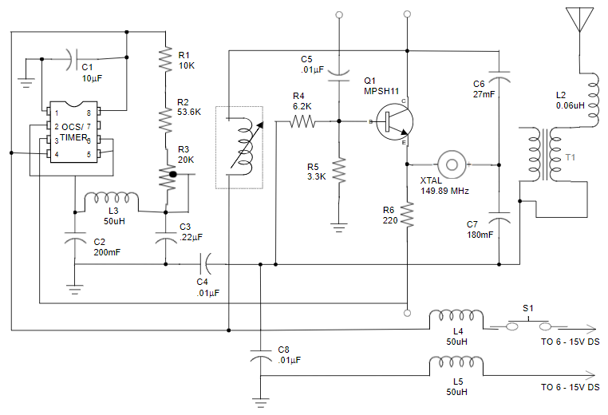
Graph

Slide 8
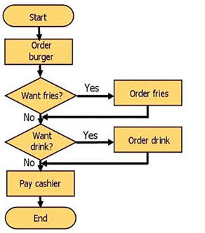
Graph

Slide 9
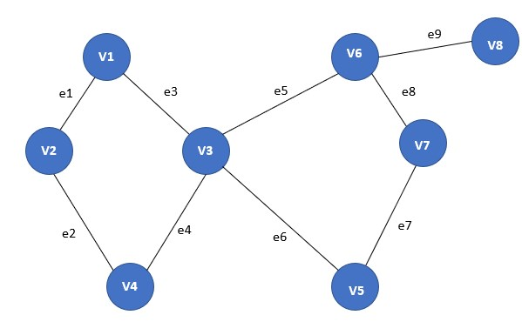
Graph

Slide 10
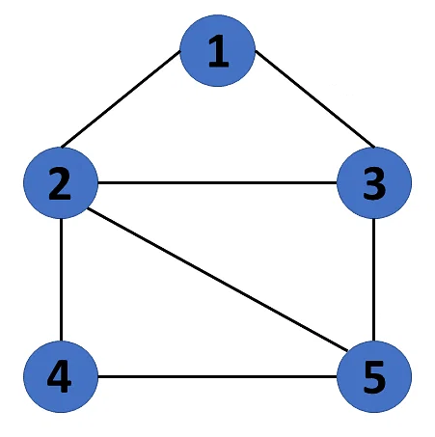
Graph
A graph G consists of two sets:
Set V, set of all vertices
Set E, set of all edges
V = {1, 2, 3, 4, 5}
E = {(1,2), (1,3), (2,3), (2,4), (2,5), (3,5),(4,5)}

Slide 11
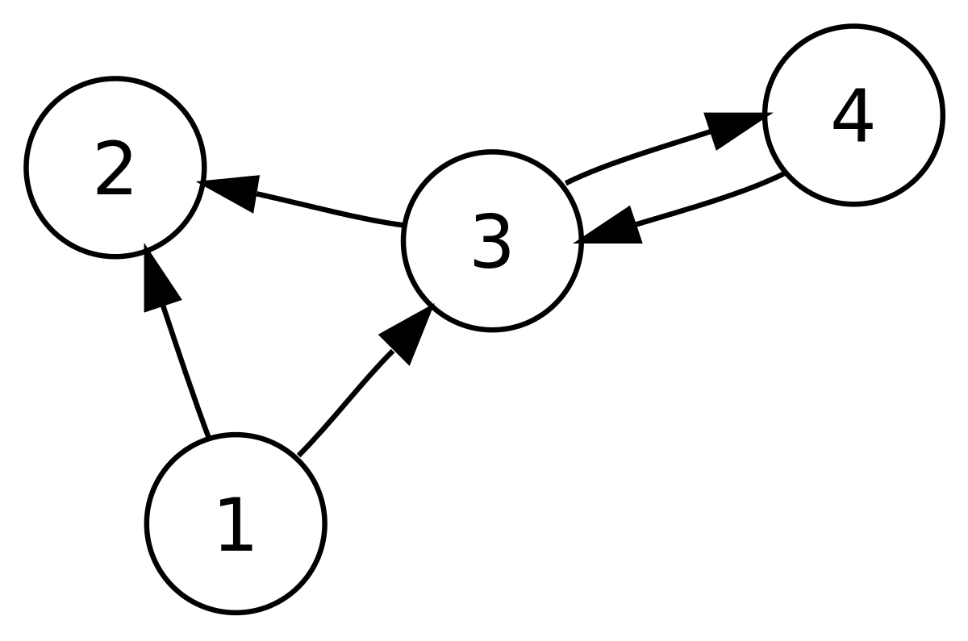
Directed graph/Digraph
A digraph G graph that is made up of a set of vertices connected by directed edges.
Set V, set of all vertices
Set E, ordered pairs of all edges
V = {1, 2, 3, 4}
E = {(1,2), (1,3), (3,2), (3,4), (4,3)}

Slide 12
Adjacency
u is adjacent to v if there exist an edge from u to v.
1 is adjacent to 2. 2 is adjacent to 1.
1 is adjacent to 3. 3 is adjacent to 1.
1 is adjacent to 2. 2 is not adjacent to 1.
1 is adjacent to 3. 3 is not adjacent to 1.

Slide 13
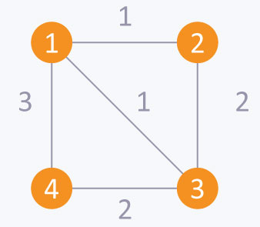
Weighted graph
A graph G consists of two sets:
Set V, set of all vertices
Set E, set of all edges with weight
(startnode, endnode, weight)
V = {1, 2, 3, 4}
E =
{(1,2,1), (1,3,1), (1,4,3), (2,3,2), (3,4,2)}

Slide 14
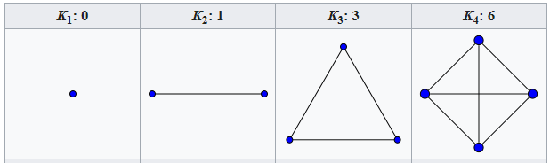
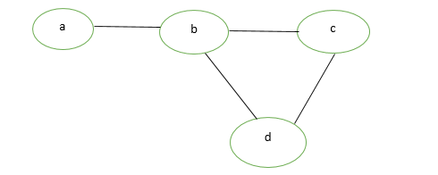
Simple graph
A simple graph is a graph having no loops and multiple edges.

Slide 15
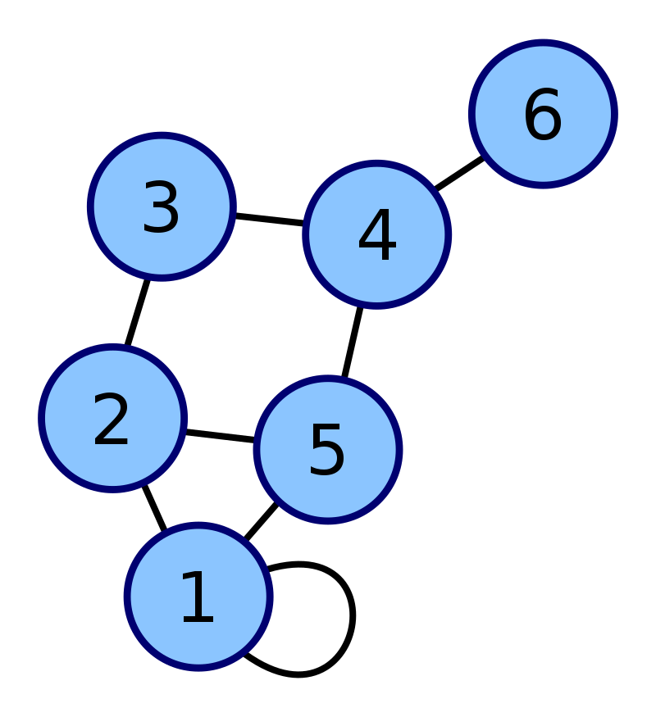
Loop in graph
A loop (also called a self-loop or a buckle) is an edge that connects a vertex to itself.

Slide 16
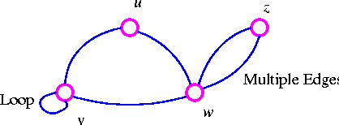
Multiple edges in graph
Multiple edges/Parallel edges are, in an undirected graph, two or more edges that are incident to the same two vertices, or in a directed graph, two or more edges with both the same tail vertex and the same head vertex.

Slide 17
Null graph
A null graph is a graph having no vertices and no edges.
V = {}
E = {}

Slide 18
Complete graph
A complete graph is a simple undirected graph in which every pair of distinct vertices is connected by a unique edge.

Slide 19
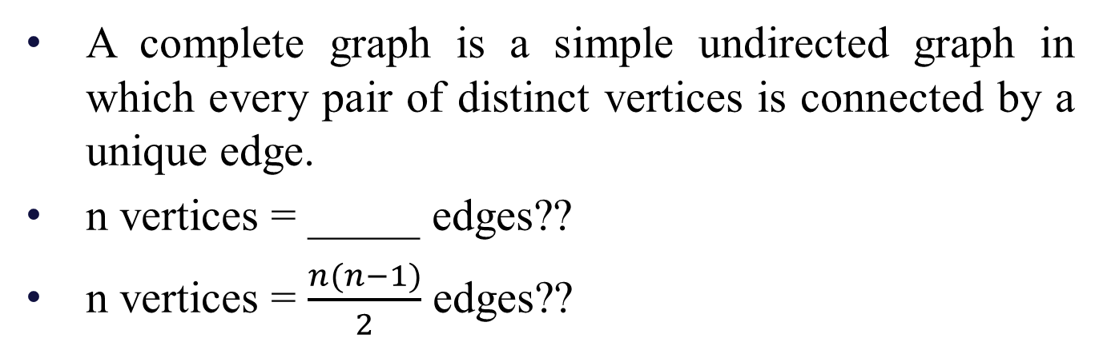
Complete graph
A complete graph is a simple undirected graph in which every pair of distinct vertices is connected by a unique edge.
n vertices = _____ edges??
n vertices = $\frac{n(n−1)}{2}$ edges??

Slide 20
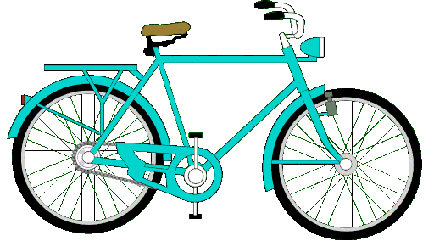

Cyclic graph
A cyclic graph or circular graph is a graph that consists of a single cycle.
Then what is cycle??

Slide 21
Some definitions
Walk: A walk is a list v₀, e₁, v₁, e₂, …, e_{k}, v_{k} where v_{i}s are vertices and e_{i} has end-points v_{i-1} and v_{i}.
Trail: A walk with no repeating edge.
Path: A walk with no repeating vertex.
Closed walk/trail: A walk/trail with same starting and ending vertices
Cycle (Closed path): A path with same starting and ending vertices

Slide 22
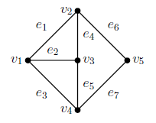
Some definitions
(v₁, e₁, v₂, e₄, v₃, e₂, v₁, e₃, v₄, e₅, v₃, e₄, v₂, e₆, v₅):
Walk, Trail, Closed Walk, Closed Trail, Path, Cycle
(v₁, e₁, v₂, e₄, v₃, e₂, v₁, e₃, v₄, e₇, v₅):
Walk, Trail, Closed Walk, Closed Trail, Path, Cycle
(v₁, e₁, v₂, e₄, v₃, e₅, v₄, e₇, v₅):
Walk, Trail, Closed Walk, Closed Trail, Path, Cycle
(v₁, e₁, v₂, e₄, v₃, e₂, v₁, e₃, v₄, e₅, v₃, e₂, v₁):
Walk, Trail, Closed Walk, Closed Trail, Path, Cycle
(v₁, e₁, v₂, e₄, v₃, e₅, v₄, e₃, v₁):
Walk, Trail, Closed Walk, Closed Trail, Path, Cycle

Slide 23
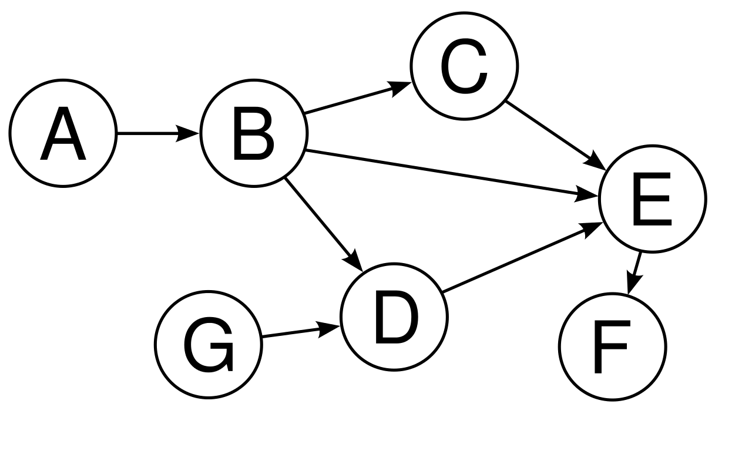
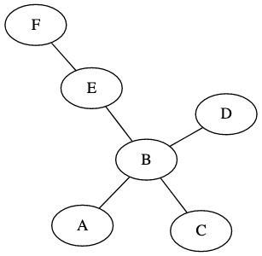
Acyclic graph
Acyclic graph is a graph that does not consist of any cycle.

Slide 24
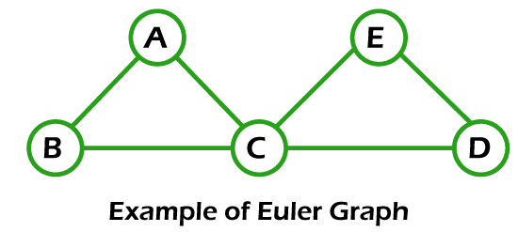
Euler Graph
A graph G consists of Euler circuit is Euler Graph.
Euler circuit: A closed trail that consists of all edges
Lemma: A given connected graph G is Euler's graph iff all vertices are of even degree.

Slide 25
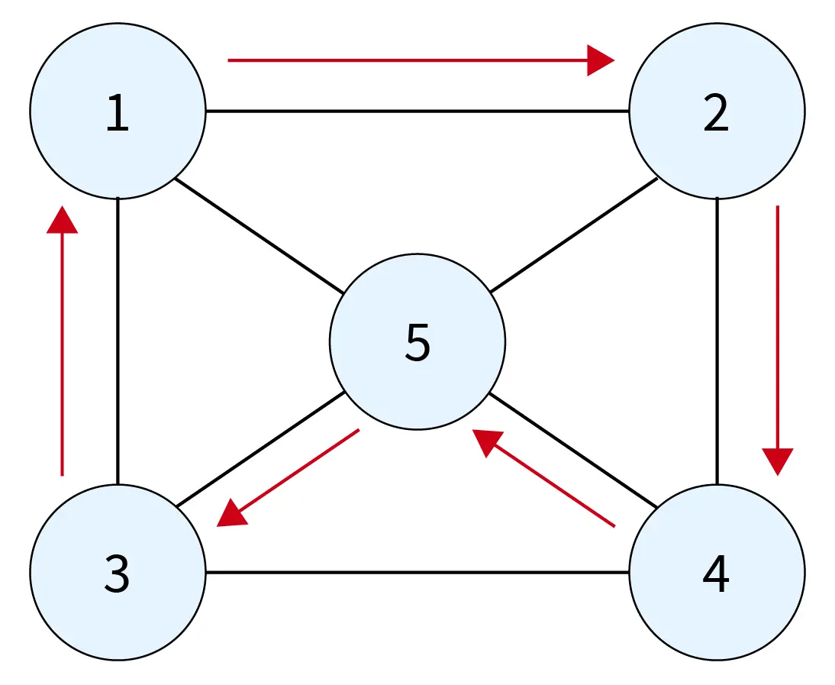
Hamiltonian Graph
A graph G consists of Hamiltonian circuit is Hamiltonian Graph.
Hamiltonian circuit: A closed trail that consists of all vertices

Slide 26
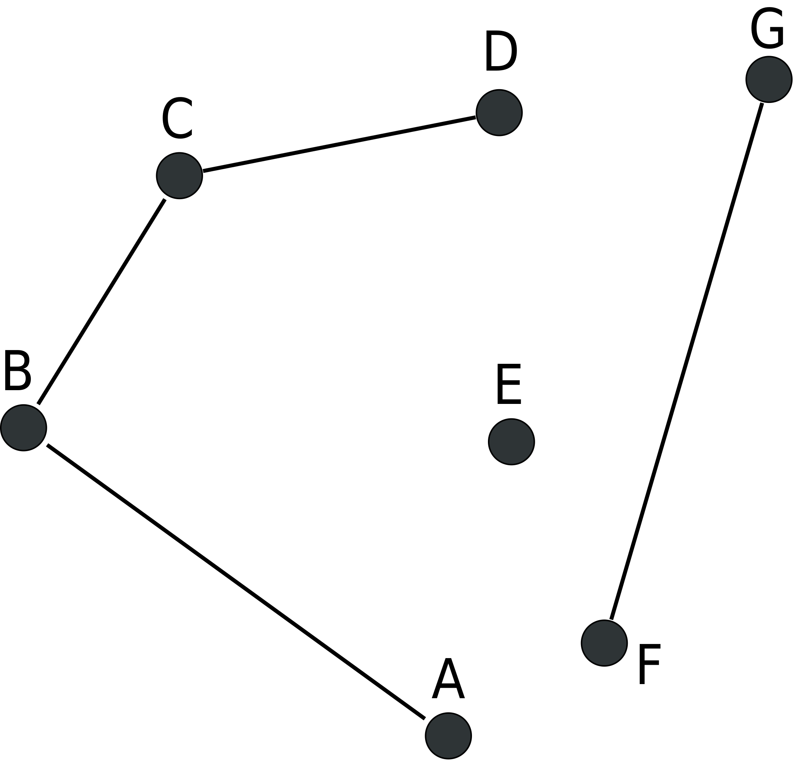
Connected Graph
A connected graph is a type of graph where there is a path between every pair of distinct vertices.

Slide 27
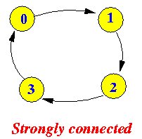
Connected Directed Graph
Strongly connected directed graph: A directed graph where there is a path between every pair of distinct vertices.
Weakly connected directed graph: A directed graph which is not connected but the undirected version of this graph is connected.
Weakly connected

Slide 28
Representation of Graph
Set representation:
V(G1) = {1, 2, 3, 4}
E(G1) = {(1,2), (1,3), (3,2), (3,4), (4,3)}
V(G2) = {1, 2, 3, 4, 5}
E(G2) = {(1,2), (1,3), (2,3), (2,4), (2,5), (3,5), (4,5)}
V(G3) = {1, 2, 3, 4}
E(G3) = {(1,2,1), (1,3,1), (1,4,3), (2,3,2), (3,4,2)}

Slide 29
Representation of Graph
Matrix representation: n x n matrix.
a_{ij} = 1 or weight, if v_{i} and v_{j} connected
= 0, otherwise
 | v1 | v2 | v3 | v4
v1 | 0 | 1 | 1 | 3
v2 | 1 | 0 | 2 | 0
v3 | 1 | 2 | 0 | 2
v4 | 3 | 0 | 2 | 0
 | v1 | v2 | v3 | v4 | v5
v1 | 0 | 1 | 1 | 0 | 0
v2 | 1 | 0 | 1 | 1 | 1
v3 | 1 | 1 | 0 | 0 | 1
v4 | 0 | 1 | 0 | 0 | 1
v5 | 0 | 1 | 1 | 1 | 0
 | v1 | v2 | v3 | v4
v1 | 0 | 1 | 1 | 0
v2 | 0 | 0 | 0 | 0
v3 | 0 | 1 | 0 | 1
v4 | 0 | 0 | 1 | 0

Slide 30
Representation of Graph
Linked list representation:
Weight | Node label | Adjacency list
1 | ●
2 | ●
3 | ●
4 | ●
2 | ●
3 | ●
1 | ●
2 | ●
3 | ●
4 | ●
2 | ●
3 | ●
1 | ●
2 | ●
3 | ●
4 | ●
2 | ●
3 | ●
4 | ●
1 | ●
3 | ●
4 | ●
5 | ●
1 | ●
3 | ●
2 | ●
4 | ●
1 | ●
2 | ●
5 | ●
1 | ●
2 | ●
4 | ●
3 | ●
2 | ●
5 | ●
1 | ●
3 | ●
5 | ●
2 | ●
3 | ●
4 | ●

Slide 31
Graph Traversals
Breadth first search (BFS)
Start by enqueuing a vertex in queue.
Dequeue a vertex from queue and enqueue its adjacent vertices into queue.
Keep repeating step 2 until queue is empty.
Depth first search (DFS)
Start by pushing a vertex in stack.
Pop the vertex from stack and push its adjacent vertices into stack.
Keep repeating step 2 until stack is empty.

Slide 32
Breadth First Search (BFS)
BFS(V)
if Graph = NULL then
print "Graph is empty"
Exit
u ← V
Q.enqueue(u)
while Q.Empty() ≠ TRUE do
u ← Q.dequeue()
if SEARCH(u, VISIT) = FALSE then
Insert(u, VISIT)
ptr ← GPTR[u]
while ptr.next ≠ NULL then
vptr ← ptr.next
Q.enqueue(vptr.LABEL)
Return VISIT
Time complexity: O(V+E)

Slide 33
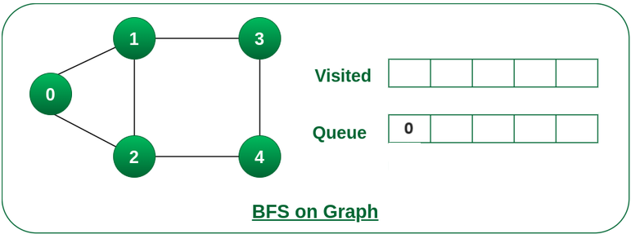
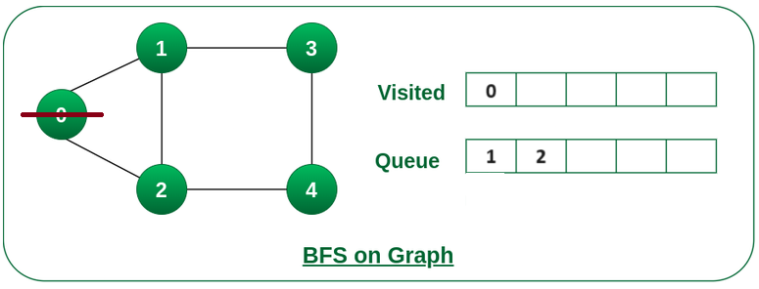
Breadth First Search (BFS)

Slide 34
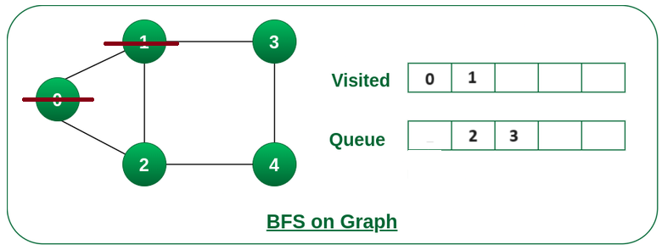
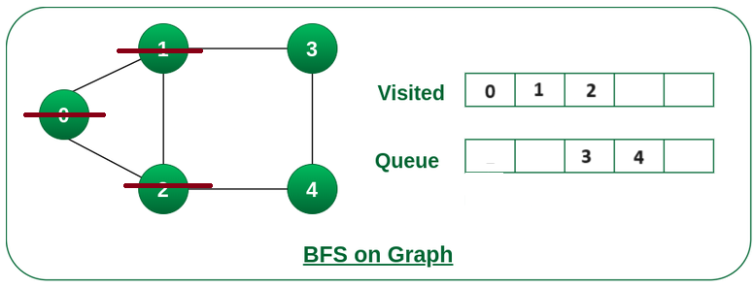
Breadth First Search (BFS)

Slide 35
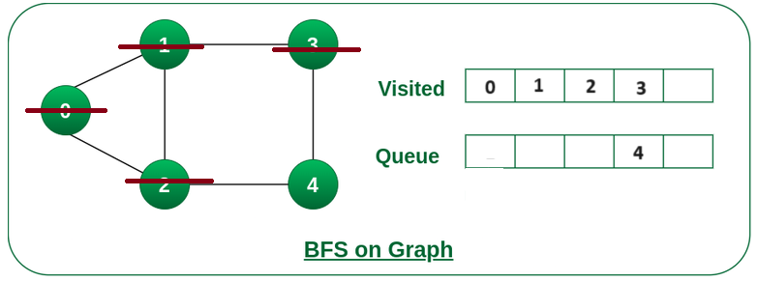
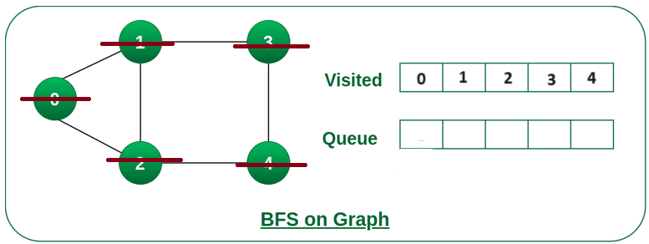
Breadth First Search (BFS)

Slide 36
Depth First Search (DFS)
DFS(V)
if Graph = NULL then
print "Graph is empty"
Exit
u ← V
S.push(u)
while S.Empty() ≠ TRUE do
u ← S.pop()
if SEARCH(u, VISIT) = FALSE then
Insert(u, VISIT)
ptr ← GPTR[u]
while ptr.next ≠ NULL then
vptr ← ptr.next
S.push(vptr.LABEL)
Return VISIT
Time complexity: O(V+E)

Slide 37
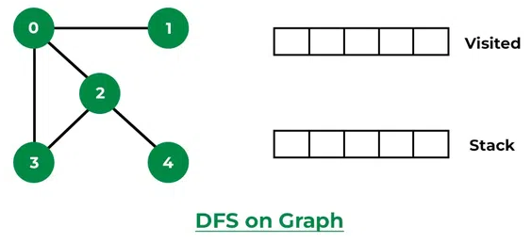
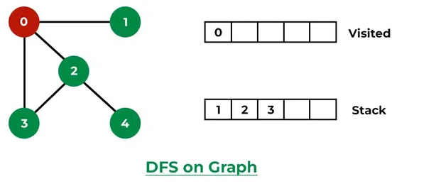
Depth First Search (DFS)

Slide 38
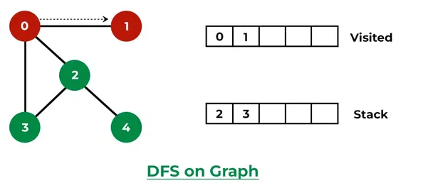
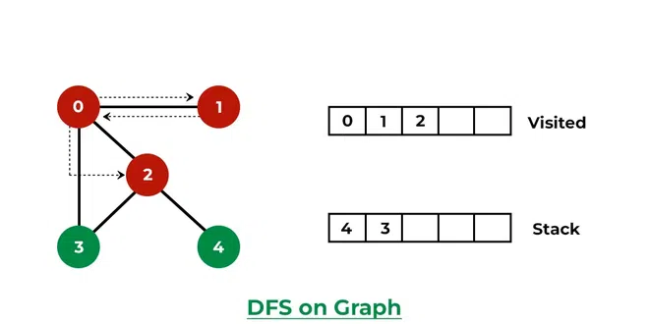
Depth First Search (DFS)

Slide 39
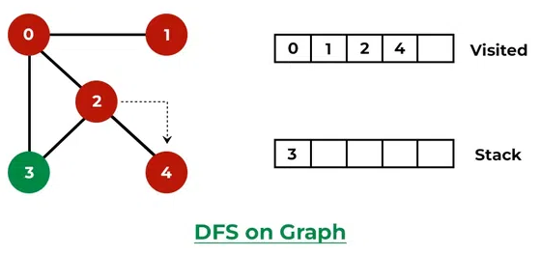
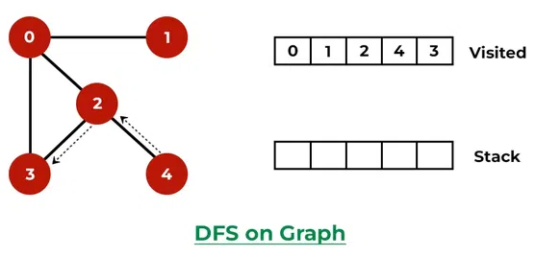
Depth First Search (DFS)

Slide 40

Optimization Problems
Greedy Algorithms
Divide and Conquer
Dynamic Programming

Slide 41
Optimization Problems
An optimization problem is a type of computational problem where the goal is to find the best solution among a set of possible solutions, often subject to certain constraints or requirements.
It involves finding the optimal solution that either maximizes or minimizes a particular objective or cost function.
Objective Function: There is an objective function that needs to be optimized.
Constraints: There are typically constraints or limitations that must be satisfied. These constraints may restrict the feasible solutions. For example, in a transportation problem, there may be constraints on the maximum capacity of vehicles.
Search Space: The search space consists of all possible solutions to the problem.
Optimal Solution: The optimal solution is the solution that achieves the best value of the objective function while satisfying all constraints. For maximization problems, this means finding the highest value; for minimization problems, it means finding the lowest value.
Feasible Solutions: Feasible solutions are those that satisfy all the constraints. The set of feasible solutions is often a subset of the entire search space.

Slide 42
Optimization Problems (Examples)
Traveling Salesman Problem (TSP): Given a list of cities and the distances between each pair of cities, the TSP seeks the shortest possible route that visits each city exactly once and returns to the original city.
Knapsack Problem: In this problem, you have a set of items, each with a weight and a value, and you need to determine the most valuable combination of items to include in a knapsack with a limited weight capacity.
Making change: The change-making problem addresses the question of finding the minimum number of coins (of certain denominations) that add up to a given amount of money.

Slide 43
Greedy Algorithms

Slide 44
Greedy Algorithms
Greedy algorithms work in stages. In each stage, a decision is made that is good at that point (local best), without bothering about future.
Greedy Choice Property: A greedy algorithm makes a series of choices, each of which is the best at that particular moment, without considering the global picture. It selects the locally optimal solution.
Optimal Substructure: The overall problem can be broken down into a collection of smaller subproblems, and solving each subproblem optimally contributes to solving the larger problem optimally.
No Backtracking: Greedy algorithms do not typically revisit or revise their choices once made. They make decisions based on the current state of the problem.
Correctness: Greedy algorithm does not always gives optimal solution.

Slide 45
Greedy Algorithms
Advantages | Disadvantages
Simplicity: Simple to understand Efficiency: Low time complexity due to fast Execution: Space Efficiency: Does not require additional storage | No Guarantee of Optimality

Slide 46
Making Change (Greedy Algorithms)
The change-making problem addresses the question of finding the minimum number of coins (of certain denominations) that add up to a given amount of money.
Suppose, dollar = 100 cents, quarter = 25 cents, dime = 10 cents, nickel = 5 cents, penny = 1 cent.
E.g.: 286 cents is 2 dollars, 3 quarters, 1 dimes, 1 penny.

Slide 47
Making Change (Greedy Algorithms)
Algorithm:
C ← {100,25,10,5,1}
S ← {}
sum ← 0
while sum != n do
x ← Largest(C) such that sum + x <= n
if no such item then
Return "No solution found"
S ← S U {x}
sum ← sum + x
Return S
n = 286
# | S (init) | sum (init) | x | S | sum
1 | {} | 0 | 100 | {100} | 100
2 | {100} | 100 | 100 | {100,100} | 200
3 | {100,100} | 200 | 25 | {100,100,25} | 225
4 | {100,100,25} | 225 | 25 | {100,100,25,25} | 250
5 | {100,100,25,25} | 250 | 25 | {100,100,25,25,25} | 275
6 | {100,100,25,25,25} | 275 | 10 | {100,100,25,25,25,10} | 285
7 | {100,100,25,25,25,10} | 285 | 1 | {100,100,25,25,25, 10,1} | 286

Slide 48
Making Change (Greedy Algorithms)
Assume that coins = {1,2,6,8} and n = 12.
So answer should be {6,6}
BUT, Greedy algorithm shows…
n = 12
# | S (init) | sum (init) | x | S | sum
1 | {} | 0 | 8 | {8} | 8
2 | {8} | 8 | 2 | {8,2} | 10
3 | {8,2} | 10 | 2 | {8,2,2} | 12

Slide 49
Knapsack Problem (Greedy Algorithms)
In this problem, you have a set of items, each with a weight and a value, and you need to determine the most valuable combination of items to include in a knapsack with a limited weight capacity.
0/1 Knapsack Problem: Items cannot be divided into fractions.
Fractional Knapsack Problem: Items can be divided into fractions.
x | 1 | 2 | 3 | 4 | 5 | 6 | 7
Profit (p) | 10 | 5 | 15 | 7 | 6 | 18 | 3
Weight (w) | 2 | 3 | 5 | 7 | 1 | 4 | 1
m = 15
Min weight: P = {6,3,10,5,18,(15*4/5)} W = {1,1,2,3,4,(5*4/5)}, Profit = 54
Max profit: P = {18,15,10,(7*4/7)} W = {4,5,2,(7*4/7)}, Profit = 50

Slide 50
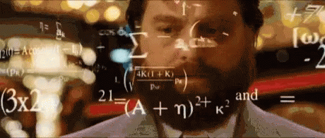
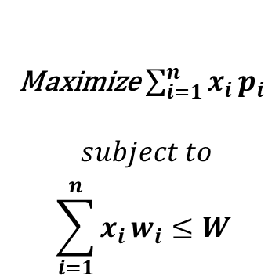
Knapsack Problem (Greedy Algorithms)
x | 1 | 2 | 3 | 4 | 5 | 6 | 7
Profit (p) | 10 | 5 | 15 | 7 | 6 | 18 | 3
Weight (w) | 2 | 3 | 5 | 7 | 1 | 4 | 1
p/w | 5 | 1.67 | 3 | 1 | 6 | 4.5 | 3
m = 15
Max p/w:{6, 5, 4.5, 3, 3, (1.67*2/3)} p:{6, 10, 18, 15, 3, (5*2/3)} w:{1, 2, 4, 5, 1, (3*2/3)}
Total Profit = 6+10+18+15+3+(5*2/3)=55.33
Maximize $\sum_{i=1}^{n}{x_{i}}p_{i}$
$$subject to$$
$$\sum_{i=1}^{n}{x_{i}}w_{i}≤W$$

Slide 51
Knapsack Problem (Greedy Algorithms)
Knapsack(w[ ], p[ ], W)
for i = 1 to n do
x[i] ← 0
pw[i] ← p[i]/w[i]
currentweight ← 0
while currentweight < W do
i ← Index(Max(pw))
pw[i] ← NULL
if (currentweight + w[i]) ≤ W then
x[i] ← 1
currentweight ← currentweight + w[i]
else
x[i] ← (W- currentweight)/w[i]
currentweight ← W
Return x

Slide 52
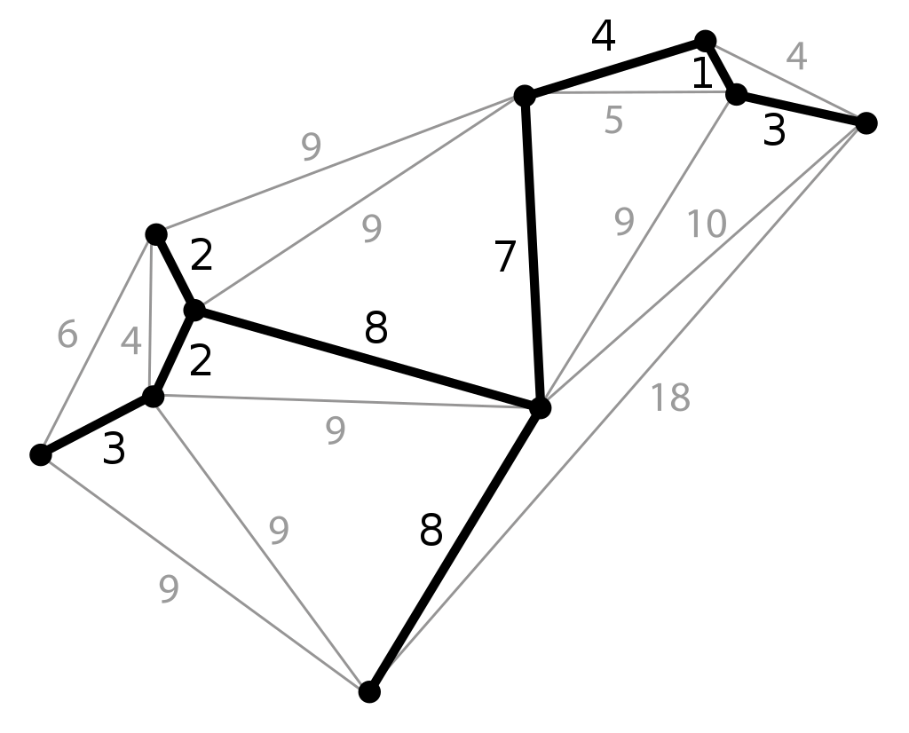
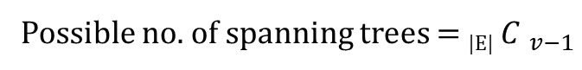
Minimum Spanning Tree
(Greedy Algorithms)
It is a subset of the edges of a connected, undirected graph that connects all the vertices together with the minimum possible total edge weight.
Possible no. of spanning trees = _{|E|}${ C }_{v−1}$

Slide 53
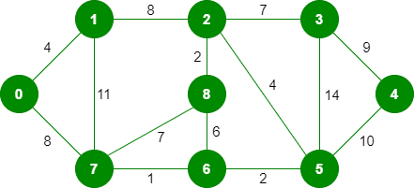
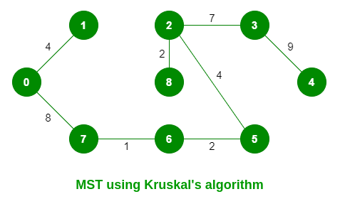
Minimum Spanning Tree
(Greedy Algorithms)
Sort all the edges in non-decreasing order of their weight.
Pick the smallest edge. Check if it forms a cycle with the spanning tree formed so far. If the cycle is not formed, include this edge. Else, discard it.
Repeat step#2 until there are (V-1) edges in the spanning tree.
Kruskal’s algorithm
Steps | Edges considered | Connected components
0 | -- | {0},{1},{2},{3},{4},{5},{6},{7},{8}
1 | {6,7} | {0},{1},{2},{3},{4},{5},{6,7},{8}
2 | {2,8} | {0},{1},{2,8},{3},{4},{5},{6,7}
3 | {5,6} | {0},{1},{2,8},{3},{4},{5,6,7}
4 | {0,1} | {0,1},{2,8},{3},{4},{5,6,7}
5 | {2,5} | {0,1},{3},{4},{2,5,6,7,8}
6 | {6,8} discarded | {0,1},{3},{4},{2,5,6,7,8}
7 | {2,3} | {0,1},{4},{2,3,5,6,7,8}
8 | {7,8} discarded | {0,1},{4},{2,3,5,6,7,8}
9 | {0,7} | {4},{0,1,2,3,5,6,7,8}
10 | {1,2} discarded | {4},{0,1,2,3,5,6,7,8}
11 | {3,4} | {0,1,2,3,4,5,6,7,8}

Slide 54
Minimum Spanning Tree
(Greedy Algorithms)
Kruskal’s algorithm(G)
Sort(E)
Tree ← {}
while |Tree| ≠ n – 1 do
e ← Min(E)
{u},{v} ← Vertices(e)
ucomp ← find(u)
vcomp ← find(v)
if ucomp ≠ vcomp then
merge(ucomp, vcomp)
Tree ← Tree ∪ {e}
Return Tree

Slide 55
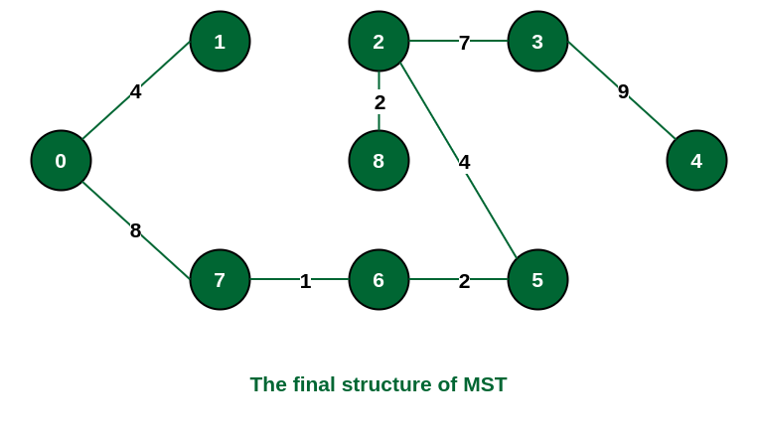
Minimum Spanning Tree
(Greedy Algorithms)
1: Determine an arbitrary vertex as the starting vertex of the MST.
2: Follow steps 3 to 5 till there are vertices that are not included in the MST (known as fringe vertex).
3: Find edges connecting any tree vertex with the fringe vertices.
4: Find the minimum among these edges.
5: Add the chosen edge to the MST if it does not form any cycle.
6: Return the MST and exit
Prim’s algorithm
Steps | Edges considered | Connected components
0 | Start with 0 | {0},{1},{2},{3},{4},{5},{6},{7},{8}
1 | {0,1} | {0,1},{2},{3},{4},{5},{6},{7},{8}
2 | {0,7} | {0,1,7},{2},{3},{4},{5},{6},{8}
3 | {6,7} | {0,1,6,7},{2},{3},{4},{5},{8}
4 | {5,6} | {0,1,5,6,7},{2},{3},{4},{8}
5 | {2,5} | {0,1,2,5,6,7},{3},{4},{8}
6 | {2,8} | {0,1,2,5,6,7,8},{3},{4}
7 | {2,3} | {0,1,2,3,5,6,7,8},{4}
8 | {3,4} | {0,1,2,3,4,5,6,7,8}

Slide 56
Minimum Spanning Tree
(Greedy Algorithms)
Prim’s algorithm(G)
Tree ← {}
B ← any arbitrary vertex from V
while B ≠ V do
find e = {u,v} of minimum length such that u ∈ B and v ∈ V - B
Tree ← Tree ∪ {e}
B ← B ∪ {v}
Return Tree

Slide 57
Task Scheduling Algorithm (Greedy Algorithms)
Given an array of jobs where every job has a deadline and associated profit if the job is finished before the deadline.
It is also given that every job takes a single unit of time, so the minimum possible deadline for any job is 1.
Maximize the total profit if only one job can be scheduled at a time.
Steps:
Sort all jobs in non-increasing order of profit.
Iterate on jobs in decreasing order of profit. For each job , do the following :
Find a time slot i, such that slot is empty and i <= deadline and i is greatest. Put the job in this slot and mark this slot filled.
If no such i exists, then ignore the job.
x_{i} | 1 | 2 | 3 | 4 | 5
p_{i} | 20 | 15 | 10 | 5 | 1
d_{i} | 2 | 2 | 1 | 3 | 3
J2
J1
J4
0
1
2
3

Slide 58
Task Scheduling Algorithm (Greedy Algorithms)
Algorithm(J[], n)
//J[i] contains profit J[i].p and deadline J[i].d
Sort J in non-decreasing order as per 'p' (profit).
for i = 1 to n do
slot[i] ← FALSE
for i = 1 to n do
for j = min(n, J[i].d) to 1 do
if slot[j] = FALSE then
result[j] = i
slot[j] = TRUE
break
Return result

Slide 59
Dijkstra’s Algorithms (Greedy Algorithms)
Given a graph and a source vertex in the graph, find the shortest paths from the source to all vertices in the given graph.
Algorithm dijkstra(graph, src)
Initialize dist[|V|]
For i = 1 to |V| do
dist[i] ← infinity or max possible value
sptset[i] ← FALSE
dist[src] ← 0
for i = 1 to |V|-1 do
u ← mindist(dist, sptset)
sptset[u] ← TRUE
for j = 1 to |V| do
if sptset[v] = FALSE then
dist[v] = min(dist[v], dist[u] + graph[u][v])
return dist

Slide 60
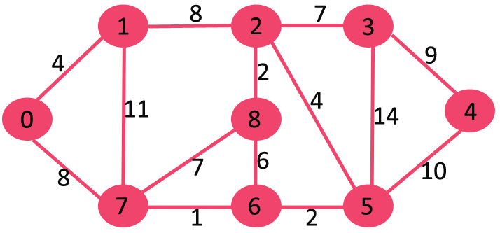
Dijkstra’s Algorithms (Greedy Algorithms)

Slide 61
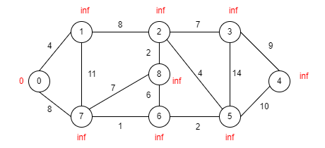
Dijkstra’s Algorithms (Greedy Algorithms)

Slide 62
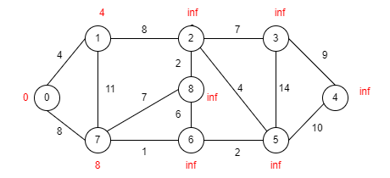
Dijkstra’s Algorithms (Greedy Algorithms)

Slide 63
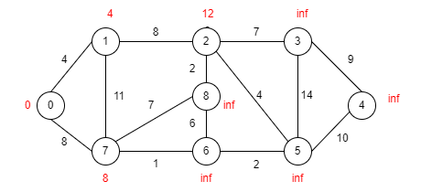
Dijkstra’s Algorithms (Greedy Algorithms)

Slide 64
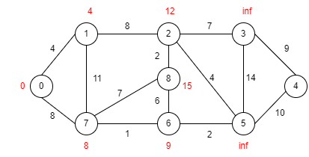
Dijkstra’s Algorithms (Greedy Algorithms)

Slide 65
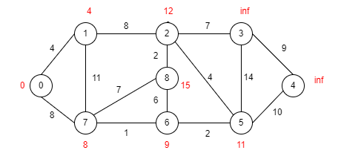
Dijkstra’s Algorithms (Greedy Algorithms)

Slide 66

Dijkstra’s Algorithms (Greedy Algorithms)

Slide 67

Dijkstra’s Algorithms (Greedy Algorithms)

Slide 68
Dijkstra’s Algorithms (Greedy Algorithms)

Slide 69
Dijkstra’s Algorithms (Greedy Algorithms)

Slide 70
Dijkstra’s Algorithms (Greedy Algorithms)

Slide 71
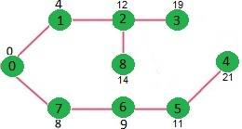
Dijkstra’s Algorithms (Greedy Algorithms)

Slide 72

Dijkstra’s Algorithms (Greedy Algorithms)
Limitations:
Non-Negative Edge Weights: Dijkstra's algorithm is designed for graphs with non-negative edge weights. If negative edge weights are present, Dijkstra's algorithm may produce incorrect results.
No Negative Cycles: Dijkstra's algorithm does not work correctly when negative cycles (cycles with a negative total weight) are present in the graph. It may enter into an infinite loop or produce incorrect results.
Negative edge weight!?!?

Slide 73
Dijkstra’s Algorithms (Greedy Algorithms)
Financial Transactions: In a financial network, negative edge weights can represent transactions or financial flows that incur costs or debts. For example, in a supply chain network, negative edge weights may indicate the costs associated with transporting goods between locations.
Transportation Networks: In transportation networks, negative edge weights can model routes or road segments where drivers receive rebates, discounts, or credits. This could be due to toll reductions, cashback offers, or other incentives for using specific routes.
Logistics and Shipping: In logistics and shipping networks, negative edge weights can symbolize savings or discounts associated with certain transportation routes, such as bulk shipping discounts or package delivery incentives.

Slide 74
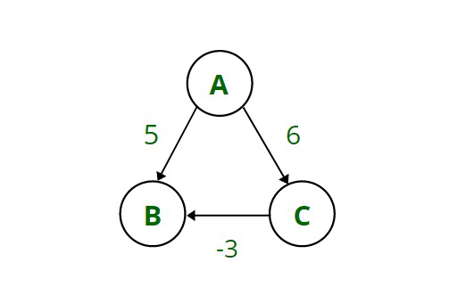
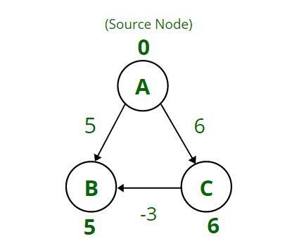
Dijkstra’s Algorithms (Greedy Algorithms)

Slide 75
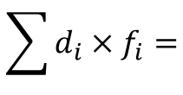
Huffman coding(Greedy Algorithms)
It is a lossless data compression algorithm. The idea is to assign variable-length codes to input characters, lengths of the assigned codes are based on the frequencies of corresponding characters.
Message: BCCABBDDAECCBBAEDDCC
Size: 20 x 8 bits = 160 bits because ASCII of A = 65 = 01000001...
Can I use my own coding in place of ASCII?
Ans: Yes
A | 3 | 001
B | 5 | 10
C | 6 | 11
D | 4 | 01
E | 2 | 000
5 X 8 = 40 |  | 12
20
0
1
0
9
1
5
11
$$\sum{d_{i}×f_{i}=}$$
0
1
0
1
E
2
A
3
D
4
B
5
C
6
(3 x 3) + (5 x 2) + (6 x 2) + (4 x 2) + (2 x 3)
= 45 bits

Slide 76
Huffman coding(Greedy Algorithms)
Algorithm(G)
<Homework>

Slide 77

Divide and Conquer

Slide 78
Divide and Conquer
It is a problem-solving strategy that involves breaking down a complex problem into simpler subproblems, solving the subproblems independently, and then combining their solutions to solve the original problem.
Widely used for optimization, search, and sorting problems.
Basic steps:
Divide: Break the problem into smaller, related subproblems that are easier to solve. This step should reduce the problem's size or complexity.
Conquer: Solve the subproblems. This can be done recursively or through other methods, depending on the specific problem.
Combine: Merge the solutions of the subproblems to obtain a solution to the original problem.

Slide 79
Divide and Conquer
Advantages | Disadvantages
Difficult problems can be solved Parallelism | Slow due to recursion Storage costs for recursive calls

Slide 80

Binary Search
(Divide and Conquer)

Slide 81
Binary Search
(Divide and Conquer)
int binarySearch(int arr[], int l, int r, int x)
{
if (r >= l) {
int mid = l + (r - l) / 2;
// If the element is present at the middle itself
if (arr[mid] == x)
return mid;
// If element is smaller than mid, then it can only be present in left subarray
if (arr[mid] > x)
return binarySearch(arr, l, mid - 1, x);
// Else the element can only be present in right subarray
return binarySearch(arr, mid + 1, r, x);
}
// We reach here when element is not present in array
return -1;
}

Slide 82
Binary Search
(Divide and Conquer)
int binarySearch(int arr[], int l, int r, int x)
{
if (r >= l) {
int mid = l + (r - l) / 2;
// If the element is present at the middle itself
if (arr[mid] == x)
return mid;
// If element is smaller than mid, then it can only be present in left subarray
if (arr[mid] > x)
return binarySearch(arr, l, mid - 1, x);
// Else the element can only be present in right subarray
return binarySearch(arr, mid + 1, r, x);
}
// We reach here when element is not present in array
return -1;
}
T(n/2)
T(n/2)
T(n) = T(n/2) + O(1)
a = 1, b = 2, k = 0, p = 0
a = b^{k},
= O(n^{k} log^{p+1} n)
= O(log n)

Slide 83

Merge Sort
(Divide and Conquer)

Slide 84
Merge Sort
(Divide and Conquer)
MERGE_SORT(arr, beg, end)
if beg < end then
mid = (beg + end)/2
MERGE_SORT(arr, beg, mid)
MERGE_SORT(arr, mid + 1, end)
MERGE (arr, beg, mid, end)
END MERGE_SORT
Merge(arr, beg, mid, end){
n1 = mid - beg + 1;
n2 = end - mid;
LeftArray[n1], RightArray[n2]; //temporary arrays
for i = 0 to n1 do
LeftArray[i] = arr[beg + i];
for j = 0 to n2 do
RightArray[j] = arr[mid + 1 + j];
i = 0, /* initial index of first sub-array */
j = 0; /* initial index of second sub-array */
k = beg; /* initial index of merged sub-array */
while i < n1 and j < n2 do
if(LeftArray[i] <= RightArray[j])then
arr[k] = LeftArray[i];
i++;
else
arr[k] = RightArray[j];
j++;
k++;
while i<n1 do
arr[k] = LeftArray[i];
i++;
k++;
while j<n2 do
arr[k] = RightArray[j];
j++;
k++;
}

Slide 85

Merge Sort (Analysis)
(Divide and Conquer)
MERGE_SORT(arr, beg, end)
if beg < end then
mid = (beg + end)/2
MERGE_SORT(arr, beg, mid)
MERGE_SORT(arr, mid + 1, end)
MERGE (arr, beg, mid, end)
END MERGE_SORT
T(n)
T(n/2)
T(n/2)
O(n)
T(n) = 2T(n/2) + O(n)
Recall Master’s theorem: 𝑇(𝑛) = 𝑎𝑇(𝑛/𝑏)+𝑔(𝑛),
where g(n) = O(n^{k}$\log^{p}$ n)
a = 2, b = 2, k = 1, p = 0
a = b^{k} and p > -1: T(n) = O(n^{k} $\log^{p+1}$ n) = O(n log n)

Slide 86
Merge Sort (Analysis)
(Divide and Conquer)
Advantages | Disadvantages
Stability Efficiency for Large Datasets External sorting possible Parallelizable | Space Complexity due to L and R Slower for Small Lists due to recursive calls

Slide 87

Quick Sort
(Divide and Conquer)

Slide 88
Quick Sort
(Divide and Conquer)
partition(arr, low, high){
pivot ← arr[high]
i ← (low - 1)
for j = low to high – 1 do
if arr[j] < pivot then
i ← i+1
swap(arr[i], arr[j])
swap(arr[i + 1], arr[high])
Return (i + 1);
}
QuickSort(arr, low, high){
if low < high then
pi ← partition(arr, low, high)
quickSort(arr, low, pi - 1)
quickSort(arr, pi + 1, high)

Slide 89
Quick Sort (Analysis)
(Divide and Conquer)
QuickSort(arr, low, high){
if low < high then
pi ← partition(arr, low, high)
quickSort(arr, low, pi - 1)
quickSort(arr, pi + 1, high)
T(n)
O(n)
T(n/2)
T(n/2)
T(n) = 2T(n/2) + O(n)
Recall Master’s theorem: 𝑇(𝑛) = 𝑎𝑇(𝑛/𝑏)+𝑔(𝑛),
where g(n) = O(n^{k}$\log^{p}$ n)
a = 2, b = 2, k = 1, p = 0
a = b^{k} and p > -1: T(n) = O(n^{k} $\log^{p+1}$ n) = O(n log n)

Slide 90
Quick Sort (Analysis)
(Divide and Conquer)
QuickSort(arr, low, high){
if low < high then
pi ← partition(arr, low, high)
quickSort(arr, low, pi - 1)
quickSort(arr, pi + 1, high)
T(n)
O(n)
T(n-1) or T(1)
T(1) or T(n-1)
T(n) = T(n-1) + O(n)
Recall Master’s theorem: 𝑇(𝑛) = 𝑎𝑇(𝑛-𝑏)+𝑔(𝑛),
where g(n) = O(n^{k})
a = 1, b = 1, k = 1
a = 1 : T(n) = O(n^{k+1}) = O(n²)

Slide 91
Quick Sort (Analysis)
(Divide and Conquer)
Advantages | Disadvantages
In-Place Sorting Parallelizable | Not stable Depends on Pivot Choice

Slide 92
Dynamic Programming

Slide 93
Dynamic Programming
A problem-solving technique to solve problems by breaking them down into smaller, overlapping subproblems and solving each subproblem only once.
Key points:
Optimal Substructure: The problem can be broken down into smaller parts, and solving these smaller parts will lead to an optimal solution for the whole problem.
Memoization: During the computation, the algorithm stores the results of previously solved subproblems in a data structure (often an array or dictionary) for later use for overlapping subproblems.

Slide 94
Dynamic Programming
Fibonacci Series:
Fib(n) = 0, if n = 0
= 1, if n = 1
= Fib(n-2) + Fib(n-1), Otherwise
int fib(int n){
if(n<=1)
return n;
else
return fib(n-2)+fib(n-1);
}
Fib(5)
Fib(3)
Fib(4)
Fib(1)
Fib(2)
Fib(3)
Fib(2)
Fib(0)
Fib(1)
Fib(2)
Fib(1)
Fib(1)
Fib(0)
T(n) = 2T(n-1) + 1
T(n) = O(2^n)
Fib(0)
Fib(1)

Slide 95
Dynamic Programming
int fib(int n){
if(n<=1)
return n;
else
F[0]=0; F[1]=1;
for(int i=2;i<=n;i++)
F[i]=F[i-2]+F[i-1];
return F[n];
}

Slide 96
Dynamic Programming
Advantages | Disadvantages
Always gives optimal solution Memoization improves efficiency | Significant memory Usage when dealing with large datasets Combinatorial explosion of subproblems Analyzing the time and space complexity can be challenging.

Slide 97
Dynamic Programming
Divide and Conquer | Dynamic Programming
Top-Down Approach: Dividing problems into smaller parts Recursion Suitable for problems with optimal substructure, but it doesn't emphasize the reusability of solutions to subproblems | Bottom-Up Approach: Starting with smaller parts Memoization Suitable for problems with optimal substructure with reusability of solutions to subproblems

Slide 98
Dynamic Programming
Greedy Algorithm | Dynamic Programming
Not guarantees optimal solution Faster Local optimization Suitable for approximation problems | Guarantees optimal solution Slower Global optimization via Memoization Not suitable for approximation problems

Slide 99
Making Change
(Dynamic Programming)
The change-making problem addresses the question of finding the minimum number of coins (of certain denominations) that add up to a given amount of money.
Suppose, dollar = 100 cents, quarter = 25 cents, dime = 10 cents, nickel = 5 cents, penny = 1 cent.
E.g.: 286 cents is 2 dollars, 3 quarters, 1 dimes, 1 penny.

Slide 100
Making Change
(Dynamic Programming)
c[i,j] = min(c[i-1,j], 1 + c[i, j-di])
E.g. coins = {1,2,6,8}, n = 12.
Greedy algorithm results: 3 coins {8,2,2}
 |  | 0 | 1 | 2 | 3 | 4 | 5 | 6 | 7 | 8 | 9 | 10 | 11 | 12
1 | di=1 | 0 | 1 | 2 | 3 | 4 | 5 | 6 | 7 | 8 | 9 | 10 | 11 | 12
2 | di=2 | 0 | 1 | 1 | 2 | 2 | 3 | 3 | 4 | 4 | 5 | 5 | 6 | 6
3 | di=6 | 0 | 1 | 1 | 2 | 2 | 3 | 1 | 2 | 2 | 3 | 3 | 4 | 2
4 | di=8 | 0 | 1 | 1 | 2 | 2 | 3 | 1 | 2 | 1 | 2 | 2 | 3 | 2
O(mxn)

Slide 101
Making Change
(Dynamic Programming)
while i!=0 and j!=0 do
if (c[i,j] = c[i-1, j]) then
i ← i-1
else
solve ← solve U di
j ← columnval – di
 |  | 0 | 1 | 2 | 3 | 4 | 5 | 6 | 7 | 8 | 9 | 10 | 11 | 12
1 | di=1 | 0 | 1 | 2 | 3 | 4 | 5 | 6 | 7 | 8 | 9 | 10 | 11 | 12
2 | di=2 | 0 | 1 | 1 | 2 | 2 | 3 | 3 | 4 | 4 | 5 | 5 | 6 | 6
3 | di=6 | 0 | 1 | 1 | 2 | 2 | 3 | 1 | 2 | 2 | 3 | 3 | 4 | 2
4 | di=8 | 0 | 1 | 1 | 2 | 2 | 3 | 1 | 2 | 1 | 2 | 2 | 3 | 2
solve = {6,6}

Slide 102
Knapsack Problem
(Dynamic Programming)
In this problem, you have a set of items, each with a weight and a value, and you need to determine the most valuable combination of items to include in a knapsack with a limited weight capacity.
0/1 Knapsack Problem: Items cannot be divided into fractions.
Fractional Knapsack Problem: Items can be divided into fractions.

Slide 103

Knapsack Problem
(Dynamic Programming)
v = {1, 6, 18, 22, 28}; w = {1, 2, 5, 6, 7}; m = 11
Maximize $\sum_{i=1}^{n}{x_{i}}p_{i}$
$$subject to$$
$$\sum_{i=1}^{n}{x_{i}}w_{i}≤W$$
P[i, j]=max(P[i-1,j], P[i-1,j-w[i]]+v[i])

Slide 104
Knapsack Problem
(Dynamic Programming)
while i!=0 and j!=0 do
if (p[i,j] = p[i-1, j]) then
i ← i-1
else
solve ← solve U di
j ← columnval – wi
i ← i-1

Slide 105

Matrix Multiplication Problem
(Dynamic Programming)
Recall matrix multiplication
A is p x q, B is q x r, so C will be p x r.
No. of multiplications = p x q x r
for i = 1 to p do
for j = 1 to r do
C[i,j] ← 0
for k = 1 to q do
C[i,j] ← C[i,j] + A[i,k] * B[k,j]

Slide 106
Matrix Chain Multiplication Problem
(Dynamic Programming)
A is 13 x 5
B is 5 x 89
C is 89 x 3
D is 3 x 34
((AB)C)D ➔ (13*5*89)+(13*89*3)+(13*3*34) = 10582
(AB)(CD) ➔ (13*5*89)+(89*3*34)+(13*89*34) = 54201
(A(BC))D ➔ (5*89*3)+(13*5*3)+(13*3*34) = 2856
A((BC)D) ➔ (5*89*3)+(5*3*34)+(13*5*34) = 4055
A(B(CD)) ➔ (89*3*34)+(5*89*34)+(13*5*34) = 26418
Do we need to check all possibilities!?
No

Slide 107
Matrix Chain Multiplication Problem
(Dynamic Programming)
 | 1 | 2 | 3 | 4
1 | 0 | 5785 | 1530 | 2856
2 | 0 | 0 | 1335 | 1845
3 | 0 | 0 | 0 | 9078
4 | 0 | 0 | 0 | 0
$$C\left[i\right]\left[j\right]=\min_{k∈[i,j)}{\text{(}\text{C}\text{[}\text{i}\text{][}\text{k}\text{] + }\text{C}\text{[}\text{k}\text{ + 1][}\text{j}\text{] + }\text{(}\text{p}\text{[}\text{i}\text{ − 1] ∗ }\text{p}\text{[}\text{k}\text{] ∗ }\text{p}\text{[}\text{j}\text{])}\text{)} }$$
A is 13 x 5, B is 5 x 89, C is 89 x 3, D is 3 x 34
p[]={13,5,89,3,34}
C[1][2]: k = 1 ➔ C[1][1] + C[2][2] + (p0*p1*p2) = 0 + 0 + (13*5*89) = 5785
C[2][3]: k = 2 ➔ C[2][2] + C[3][3] + (p1*p2*p3) = 0 + 0 + (5*89*3) = 1335
C[3][4]: k = 3 ➔ C[3][3] + C[4][4] + (p2*p3*p4) = 0 + 0 + (89*3*34) = 9078
C[1][3]: k = 1 ➔ C[1][1] + C[2][3] + (p0*p1*p3) = 0 + 1335 + (13*5*3) = 1530
k = 2 ➔ C[1][2] + C[3][3] + (p0*p2*p3) = 5785 + 0 + (13*89*3) = 9256
C[2][4]: k = 2 ➔ C[2][2] + C[3][4] + (p0*p1*p4) = 0 + 9078 + (13*5*3) = 24208
k = 3 ➔ C[2][3] + C[4][4] + (p1*p3*p4) = 1335 + 0 + (5*3*34) = 1845
C[1][4]: k = 1 ➔ C[1][1] + C[2][4] + (p0*p1*p4) = 0 + 1845 + (13*5*34) = 4055
k = 2 ➔ C[1][2] + C[3][4] + (p0*p2*p4) = 5785 + 9078 + (13*89*34) = 54201
k = 3 ➔ C[1][3] + C[4][4] + (p0*p3*p4) = 1530 + 0 + (13*3*34) = 2856
 | 1 | 2 | 3 | 4
1 | 0 | 1 | 1 | 3
2 | 0 | 0 | 2 | 3
3 | 0 | 0 | 0 | 3
4 | 0 | 0 | 0 | 0

Slide 108
Matrix Multiplication Problem
(Dynamic Programming)
int C[n][n]
int K[n][n]
int i, j, k, L, q
//Initialize...
for i = 0 to n-1 do
for j = 0 to n-1 do
C[i][j] ← 0
K[i][j] ← 0
// L is chain length.
for L = 2 to n-1 do
for i = 1 to n - L do
j ← i + L - 1
if (j == n) then
continue
C[i][j] ← Integer.MAX_VALUE
for k = i to j - 1 do
q ← C[i][k] + C[k + 1][j] + (p[i - 1] * p[k] * p[j])
if q < C[i][j] then
C[i][j] ← q
K[i][j] ← k
Return C[1][n-1]

Slide 109
Bellman Ford Algorithm (Dynamic Algorithms)
Bellman-Ford is a single source shortest path algorithm that determines the shortest path between a given source vertex and every other vertex in a graph.
A Bellman-Ford algorithm is also guaranteed to find the shortest path in a graph, similar to Dijkstra’s algorithm.
Bellman-Ford is capable of handling graphs with negative edge weights.
The shortest path cannot be found if there exists a negative cycle in the graph.

Slide 110
Bellman Ford Algorithm (Dynamic Algorithms)
-1
 |  | 1 | 2 | 3 | 4 | 5 | 6
1 | 0 | 0 | 0 | 0 | 0 | 0 | 0
2 | Inf
3 | Inf
4 | Inf
5 | Inf
6 | Inf
7 | Inf
2
5
6
3
-2
1
5
1
3
7
5
-2
3
4
6
-1
(1,2),(1,3),(1,4),(2,5),(3,2),(3,5),
(4,3),(4,6),(5,7),(6,7)
if ((dist[u] + weight) < dist[v]) then
dist[v] = dist[u] + weight

Slide 111
Bellman Ford Algorithm (Dynamic Algorithms)
-1
 |  | 1 | 2 | 3 | 4 | 5 | 6
1 | 0 | 0 | 0 | 0 | 0 | 0 | 0
2 | Inf | 3 | 1 | 1 | 1 | 1 | 1
3 | Inf | 3 | 3 | 3 | 3 | 3 | 3
4 | Inf | 5 | 5 | 5 | 5 | 5 | 5
5 | Inf | 5 | 2 | 0 | 0 | 0 | 0
6 | Inf | 4 | 4 | 4 | 4 | 4 | 4
7 | Inf | 7 | 5 | 3 | 3 | 3 | 3
2
5
6
3
-2
1
5
1
3
7
5
-2
3
4
6
-1
(1,2),(1,3),(1,4),(2,5),(3,2),(3,5),
(4,3),(4,6),(5,7),(6,7)
if ((dist[u] + weight) < dist[v]) then
dist[v] = dist[u] + weight

Slide 112
Bellman Ford Algorithm (Dynamic Algorithms)
BellmanFord(G)
for i = 1 to |V| do
dist[i] = Integer.MAX_VALUE;
dist[src] = 0;
for i = 1 to |V|-1 do
for j = 1 to |E| do
u ← E[j].src;
v ← E[j].dest;
weight ← E[j].weight;
if ((dist[u] + weight) < dist[v]) then
dist[v] ← dist[u] + weight
for j = 1 to |E| do
u ← E[j].src;
v ← E[j].dest;
weight ← E[j].weight;
if ((dist[u] + weight) < dist[v]) then
print "Graph contains negative weight cycle"
Exit
Return dist
O(|V-1|x|E|)

Slide 113
Floyd Warshall Algorithm (Greedy Algorithms)
It is an algorithm for finding shortest paths in a directed weighted graph with positive or negative edge weights (but with no negative cycles).
Although it does not return details of the paths themselves, it is possible to reconstruct the paths with simple modifications to the algorithm.

Slide 114

Floyd Warshall Algorithm (Dynamic Algorithms)

Slide 115

Floyd Warshall Algorithm (Dynamic Algorithms)

Slide 116

Floyd Warshall Algorithm (Dynamic Algorithms)

Slide 117

Floyd Warshall Algorithm (Dynamic Algorithms)

Slide 118

Floyd Warshall Algorithm (Dynamic Algorithms)

Slide 119

Floyd Warshall Algorithm (Dynamic Algorithms)

Slide 120

Floyd Warshall Algorithm (Dynamic Algorithms)

Slide 121
Floyd Warshall Algorithm (Dynamic Algorithms)
Algorithm(G)
for k = 1 to |V| do
// Pick all vertices as source one by one
for i = 1 to |V| do
// Pick all vertices as destination for the above picked source
for j = 1 to |V| do
// If vertex k is on the shortest path from i to j, then update the value of dist[i][j]
if(dist[i][k] + dist[k][j] < dist[i][j]) then
dist[i][j] =
min(dist[i][j], (dist[i][k] + dist[k][j]))
O(|V|x|V|x|V|)

Slide 122
References
Algorithms Design: Foundations, Analysis and Internet Examples Michael T. Goodrich, Roberto Tamassia, 2006, Wiley (Students Edition)
Data Structures, Algorithms and Applications in C++, Sartaj Sahni, Second Ed, 2005, Universities Press
Introduction to Algorithms, TH Cormen, CE Leiserson, RL Rivest, C Stein, Third Ed, 2009, PHI

Slide 123
Any Question!!

Slide 124
Thank you!!

